Slide 1
Pre-assessment Questions
  1. ______________ allow integration of applications developed in different languages and running on different platforms.
  a. JSP applications
  b. Web services
  c. Servlet applications
  d. XML applications
  2. ______________ is responsible for providing the software components that are published as Web services.
  a. Service registry
  b. Service client
  c. Service provider
  d. Service broker

Slide 2
Pre-assessment Questions (Contd.)
  3. Web services are published to ______________.
  a. Service registry
  b. Service broker
  c. Service client
  d. Service provider
  4. ___________ protocol enables communication between the Web services and its clients.
  a. SOAP
  b. WSDL
  c. UDDI
  d. XML

Slide 3
Pre-assessment Questions (Contd.)
  5. ___________ standard describes a Web service that is published in a service registry.
  a. SOAP
  b. WSDL
  c. UDDI
  d. XML

Slide 4
Solutions to Pre-assessment
Questions (Contd.)
  1. b. Web services
  2. c. Service provider
  3. a. Service registry
  4. a. SOAP
  5. b. WSDL

Slide 5
Objectives
  In this lesson, you will learn about:
    Document-Oriented JAXP APIs
    Creating applications using SAX, DOM, and XSLT API

Slide 6
JAXP APIs
  JAXP is a collection of APIs that you can use in your Java applications to process and translate XML documents. JAXP consists of three APIs:
    Simple API for XML (SAX): Allows you to use a SAX parser to process the XML documents serially.
    Document Object Model (DOM): Allows you to use a DOM parser to process the XML documents in an object-oriented manner.
    XML Stylesheet Language for Transformation (XSLT): Allows you to transform XML documents in other formats, such as HyperText Markup Language (HTML).

Slide 7
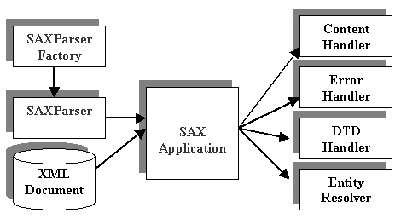
Using SAX API
  The working of SAX includes:
    SAX uses various classes and interfaces that are defined in the SAX API to process XML document in the form of a stream of data.
    The SAX parser also notifies your application each time it recognizes any syntax constructs in the XML document. The following figure shows the working of the SAX:

Slide 8
Using SAX API (Contd.)
  SAX API Packages are:
    org.xml.sax
    org.xml.sax.ext
    org.xml.sax.helpers
    javax.xml.parsers
  The steps to parse an XML document are:
    Import the required packages
    Extend the DefaultHandler Interface
    Parse the XML Document
    Override the call back methods

Slide 9
Demonstration-Parsing XML Document Using SAX API
  Problem Statement
    ABC Books has implemented a Web service that allows them to perform online trading of books. Information of books is exchanged between the organization and their clients as XML documents. Larry Williams, manager of ABC Books, needs to process these XML documents before sending them to the clients. Larry instructs Don Allen, the software engineer to develop a Java application that will process the XML documents. Don Allen decides to process the XML documents using SAX API.

Slide 10
Demonstration-Parsing XML Document Using SAX API(Contd.)
  Solution
    1. Create an XML document that needs to be parsed.
    2. Develop the Java class to parse the XML document and display its contents.
    3. Compile and run the application.

Slide 11
Using DOM API
  The working of DOM includes:
    DOM uses various classes and interfaces that are defined in the DOM API to process XML document in the form a tree structure, known as DOM tree.
    DOM tree consists of nodes, where each node represents a component of the XML document. Different types of nodes supported by DOM API are:
      Element node
      Text node
      Attribute node

Slide 12
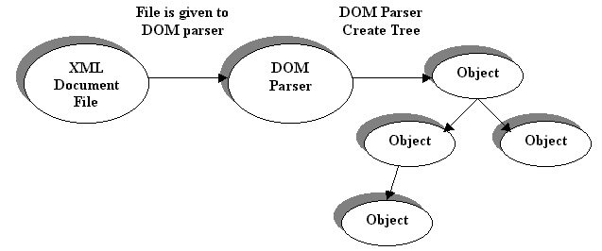
Using DOM API (Contd.)
  The following figure shows the working of DOM API:

Slide 13
Using DOM API (Contd.)
  DOM API Packages are:
    org.w3c.dom
    javax.xml.parsers
  The steps to parse and display XML document using DOM are:
    Import the DOM API related classes
    Parse the XML document
    Identify the various types of DOM nodes

Slide 14
Demonstration-Parsing XML Document Using DOM API
  Problem Statement
    New Tech Books has implemented a Web service that allows online trading of books. Information of books is exchanged between the organization and their clients as XML documents. Ronald Billing, manager of New Tech Books instructs Jerry Smith, the software engineer to develop a Java application that can parse the XML documents and display the elements of the XML document and their contents. Jerry Smith decides to parse the XML documents using DOM API.

Slide 15
Demonstration-Parsing XML Document Using DOM API (Contd.)
  Solution
    1. Write Java code that imports the various DOM related classes. In addition, the code should also identify the various types of nodes present in the XML file.
    2. Compile and run the DOM application.

Slide 16
Using XSLT API
  Working of XSLT: To transform an XML document into other format such as HTML. XSLT API needs three components:
    An instance of the TransformerFactory
    An instance of the Transformer
    The predefined transformation instructions

Slide 17
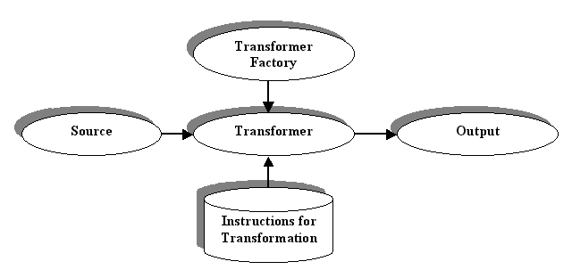
Using XSLT API (Contd.)
  The following figure shows the working of the XSLT API:

Slide 18
Using XSLT API (Contd.)
  The various packages of XSLT API are:
    javax.xml.transform
    javax.xml.transform.dom
    javax.xml.transform.sax
    javax.xml.transform.stream
  The steps to transforming an XML document are:
    Create a Stylesheet
    Create a Java class to transform an XML document

Slide 19
Demonstration-Parsing XML Document Using XSLT API
  Problem Statement
    New Tech Books has a Web service that allows online trading of books. Information of books is exchanged between the organization and their clients as XML documents. Tom Wilkins, manager of New Tech Books, needs to view these XML files in the HTML format. Tom instructs Jerry Smith, the software engineer to develop a Java application that can transform the XML documents in the HTML format. Jerry Smith decides to transform the XML documents using XSLT API.

Slide 20
Demonstration-Parsing XML Document Using XSLT API (Contd.)
  Solution
    Create an XSL file for the corresponding XML file.
    Writing the Java code that imports the various transformation related classes.
    Compile and run the XSLT application.

Slide 21
Summary
  In this lesson, you learned that:
    JAXP is the Java API for processing XML documents.
    JAXP API consists of three APIs
      The SAX API
      The DOM API
      The XSLT API
    You use the SAX and DOM APIs to parse various XML documents.
    You use the XSLT API to transform various input source documents into different types of output result documents, such as HTML, XHTML, and WML.

Slide 22
Summary (Contd.)
  Various packages that JAXP provides to parse and transform XML documents are:
    org.xml.sax
    org.xml.sax.ext
    org.xml.sax.helpers
    javax.xml.parser
    org.w3c.dom
    javax.xml.transform
    javax.xml.transform.dom
    javax.xml.transform.sax
    javax.xml.transform.stream

Slide 23
Summary (Contd.)
  Various types of interfaces that the SAX parser uses to parse an XML document are:
    ContentHandler
    ErrorHandler
    DTDHandler
    EntityHandler

